Slide 1
Building trust in and within an organization
Marketing Associates of Spokane
November 13, 2014
Bill Robinson
Notes:
Organizations, communities and relationships

Slide 2
Tuesday, 11/11/14 on Squawk Box
David Faber at the end of an hour interview: and so--if I have to ask you to describe the culture of Alibaba, what is it?
Jack Ma: trust and transparent.

Slide 3
The three components of trust - both in and within an organizational context
Competence – do you have the ability?
Character – can I count on you? Do you have the motivation and integrity?
Value alignment – do our values line up?
Competence + Character + values = Confidence
Businesses need all three - Covey builds business case for trust (speedier).
Notes:
Leadership – Nixon and Carter
Speed of trust – TJ Max – she wasn’t trusted so she couldn’t trust me.

Slide 4
1. Trust in your firms

Slide 5
The latest data on trust
From Edelman’s 2014 Trustbarometer findings:
Trust in businesses has flattened with trust in government continuing to decline, yet globally the desire for more regulation over business has grown.
Trust in media declined significantly in 2014.
Small and family owned businesses are more trusted than big businesses.
Peers are trusted more than leaders – see next slide
Between 2008 and 2013, a massive change occurred in why people trust companies: 2008 – operational excellence was most important for 76% of general population; in 2013, operational excellence had fallen to being most important for 39% of population.
Most important in 2014? – Engagement, integrity, mission/purpose.
Conclusion: the presence of trust is declining and the importance of trust is rising.

Slide 6
The role of trust in the marketing process…
What is the main message we want to communicate?
Who are we mainly hoping to reach?
What is the main benefit for the people we want to reach?
Who is the most trusted source?
What is the most trusted channel to reach our target market?

Slide 7
Trusted sources

Slide 8
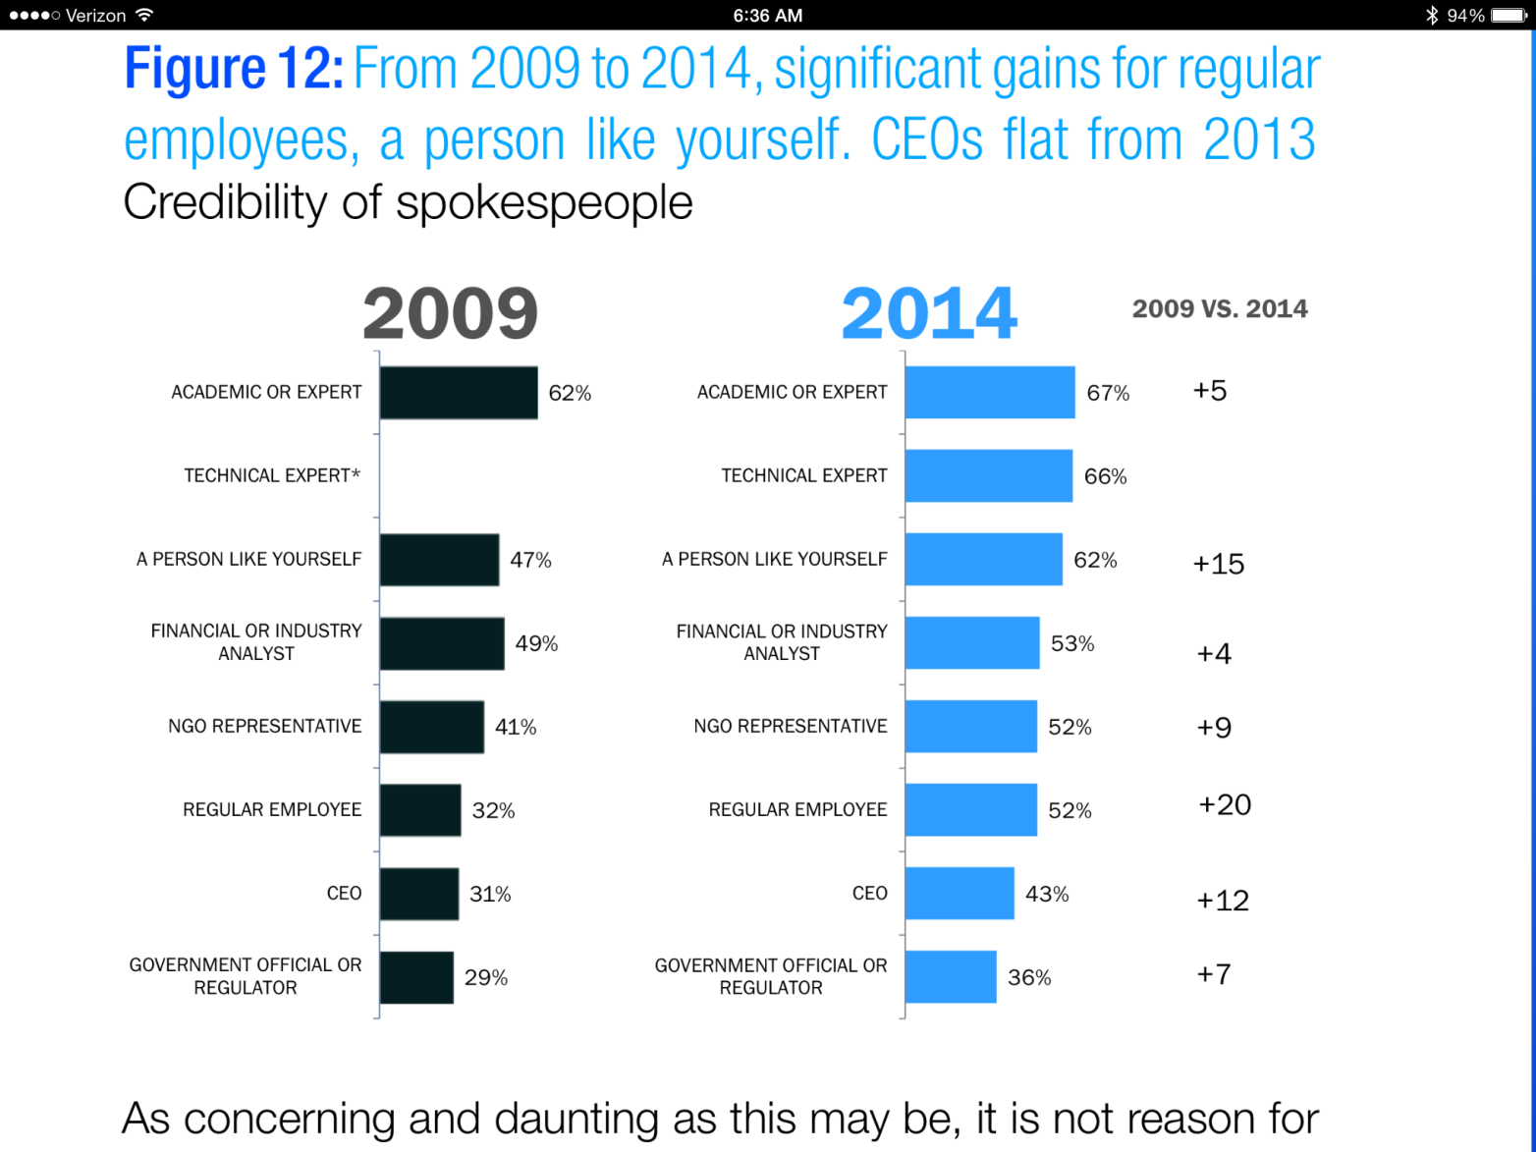
Trusted spokespeople

Slide 9
2. Trust within your firms
What are the characteristics of organizations that enjoy high trust levels within their cultures?
Notes:
I mistakenly had tryst

Slide 10
1. a clear and supported mission
The mission must be known and embraced by the organization.
Clarity about an organization’s identity and purpose enables trust. Ambiguity about an organization’s mission breeds cross purposes that dilute trust.
Mission clarity requires specificity and differentiation.
When the mission is clear and embraced…
Different points of view on strategies are valuable because the mission has been settled.
It buffs up the middle.
Notes:
The trust level shoots up when people are confident that everyone knows what you’re trying to do – service projects within a university, for example, who is it for?

Slide 11
2. Respected people
Trust is built upon deep respect for every member of the community.
Cultures of trust presuppose respect for everyone on the team.
Hierarchies feel gentle rather than stern. The Pope Francis effect.
Leaders know how to ask questions without questioning.
Leadership is provided by many, not just the position holders.
Non-mainstream people feel “I’m in the minority…and I belong.”

Slide 12
3. Empowered people
Empowerment is trust’s reward.
The best organizations ended the 20th century replacing their chains of command with chains of service. The people on the front lines are
Able
Well-trained
Equipped (have needed resources)
Authorized
Confident
People who are empowered are trusted…and trust breeds trust.
PS, over-trust also breeds misbehavior.
Notes:
Soden making a decision to make an exception

Slide 13
4. Informed people
The relationship between transparency and trust is circular. Transparency…
Stands on trust.
Replaces speculation with information.
Encourages questions.
Encourages big picture-taking.
Provides a common information to advance the mission.
Quotable quote: “I never understood why Clark Kent was so hell bent on keeping Lois Lane in the dark.” ― Audrey Niffenegger, The Time Traveler's Wife

Slide 14
The rest of Jack Ma’s quote…
'Cause we are working with-- my company and the team have-- we have 30 thousand smart people. If you work with the smart people, you gotta be transparent. You gotta making sure they trust you and you trust them and making sure that everybody have the same vision-- and vision and value.

Slide 15
5. Accountability
“Doveryai, no proveryai”
Trust but verify
Transparency, independence and communication = triple guarantee of accountability

Slide 16
More quotes…
“To be trusted is a greater compliment than being loved.” ― George MacDonald
“The best way to find out if you can trust people is to trust them.” ― Ernest Hemingway
“All the world is made of faith, and trust, and pixie dust.” ― J.M. Barrie, Peter Pan

Slide 17
Thanks

